Slide 1
Image Motion

Slide 2
The Information from Image Motion
3D motion between observer and scene + structure of the scene
Wallach O’Connell (1953): Kinetic depth effect
http://www.michaelbach.de/ot/mot-ske/index.html
Motion parallax: two static points close by in the image with different image motion; the larger translational motion corresponds to the point closer by (smaller depth)
Recognition
Johansson (1975): Light bulbs on joints
http://www.biomotionlab.ca/Demos/BMLwalker.html

Slide 3
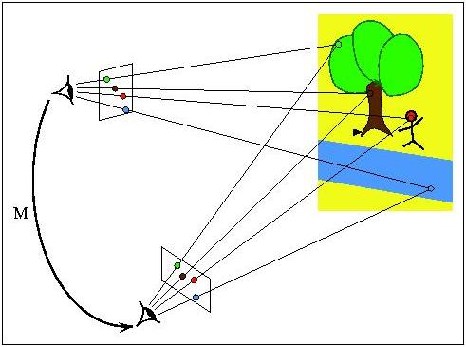
The problem of motion estimation

Slide 4
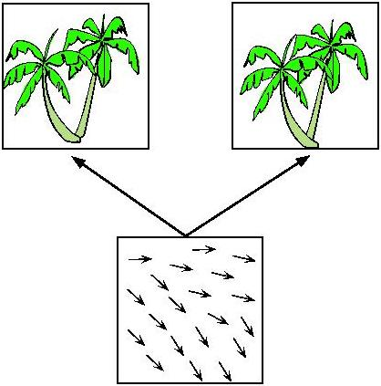

Slide 5
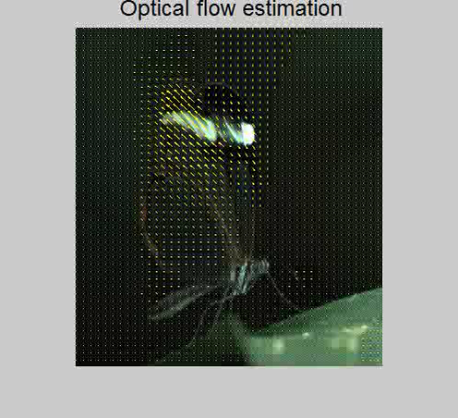

Slide 6
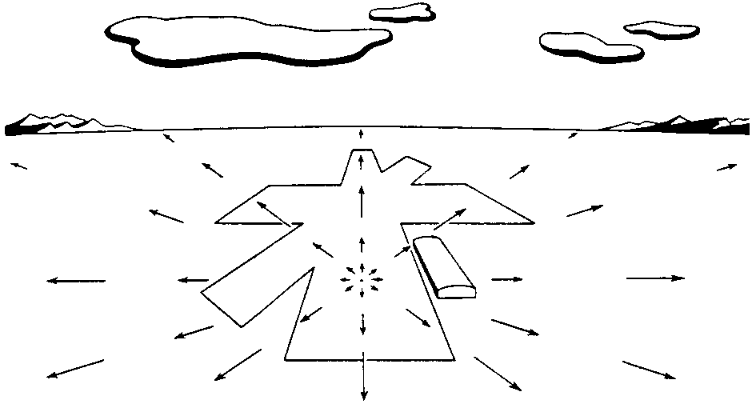
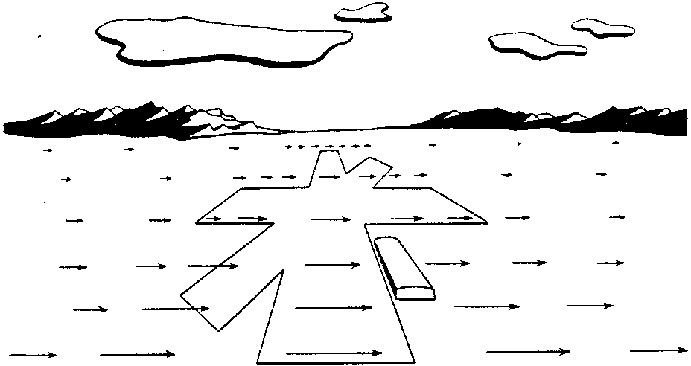
Examples of Motion Fields I
(a) (b)
(a) Motion field of a pilot looking straight ahead while approaching a fixed point on a landing strip. (b) Pilot is looking to the right in level flight.

Slide 7
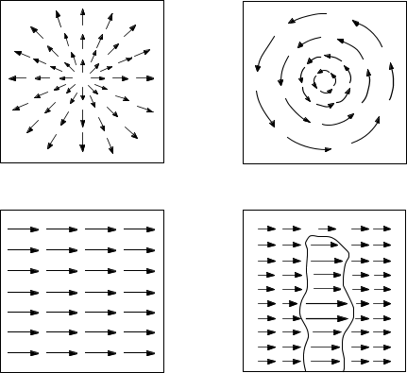
Examples of Motion Fields II
(a) (b)
(c) (d)
(a) Translation perpendicular to a surface. (b) Rotation about axis perpendicular to image plane. (c) Translation parallel to a surface at a constant distance. (d) Translation parallel to an obstacle in front of a more distant background.

Slide 8
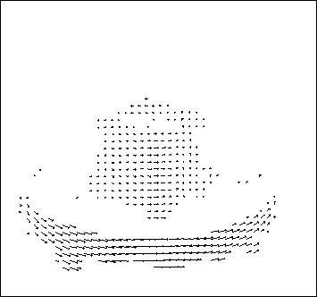
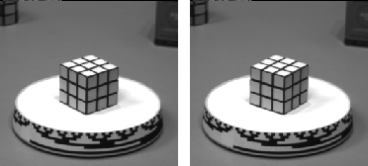
Optical flow

Slide 9
Assuming that illumination does not change:
Image changes are due to the RELATIVE MOTION between the scene and the camera.
There are 3 possibilities:
Camera still, moving scene
Moving camera, still scene
Moving camera, moving scene

Slide 10
Motion Analysis Problems
Correspondence Problem
Track corresponding elements across frames
Reconstruction Problem
Given a number of corresponding elements, and camera parameters, what can we say about the 3D motion and structure of the observed scene?
Segmentation Problem
What are the regions of the image plane which correspond to different moving objects?

Slide 11
Motion Field (MF)
The MF assigns a velocity vector to each pixel in the image.
These velocities are INDUCED by the RELATIVE MOTION btw the camera and the 3D scene
The MF can be thought as the projection of the 3D velocities on the image plane.

Slide 12
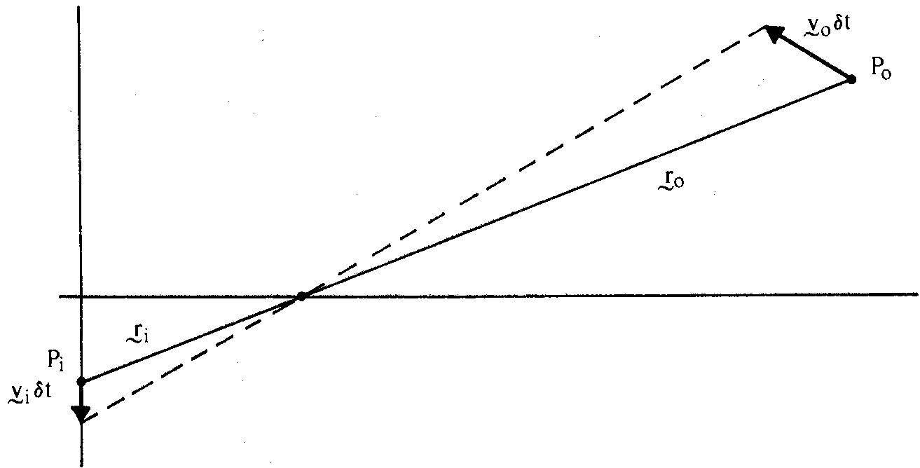
Motion Field and Optical Flow Field
Motion field: projection of 3D motion vectors on image plane
Optical flow field: apparent motion of brightness patterns
We equate motion field with optical flow field

Slide 13
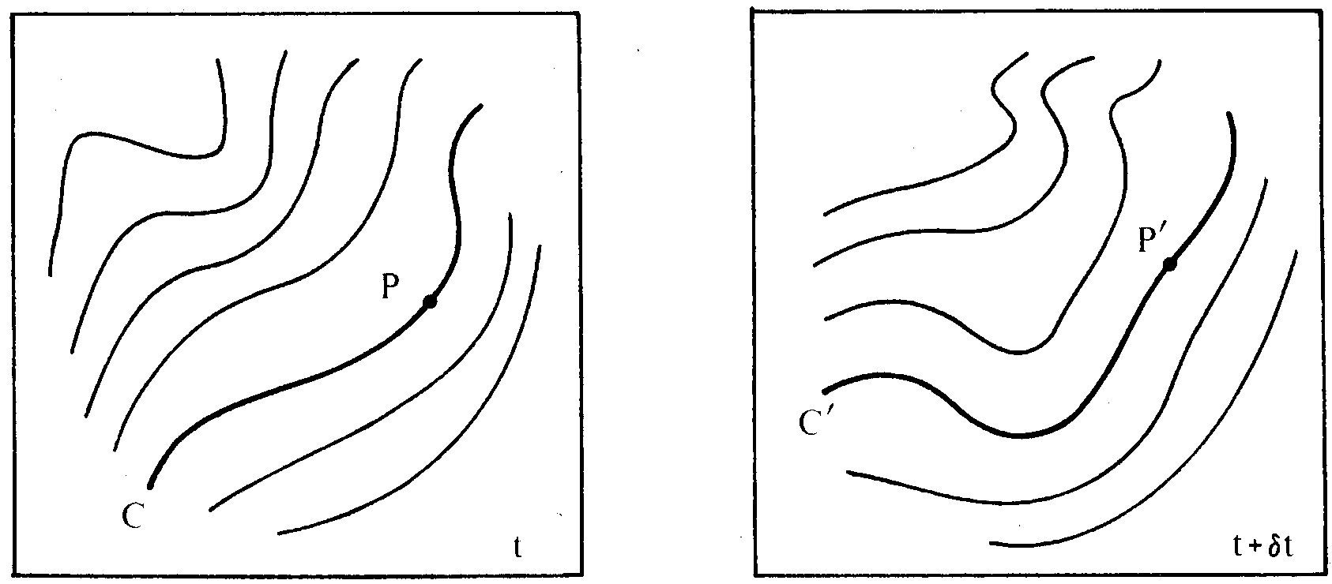
What is Meant by Apparent Motion of Brightness Pattern?
The apparent motion of brightness patterns is an awkward concept. It is not easy to decide which point P' on a contour C' of constant brightness in the second image corresponds to a particular point P on the corresponding contour C in the first image.

Slide 14
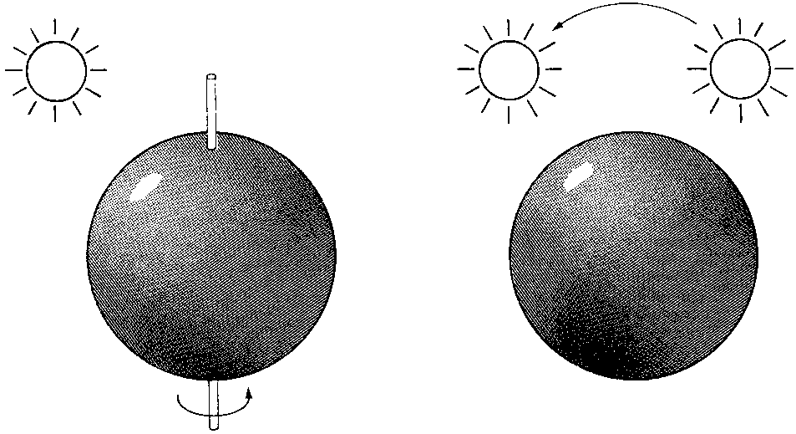
2 Cases Where this Assumption Clearly is not Valid
(a) A smooth sphere is rotating under constant illumination. Thus the optical flow field is zero, but the motion field is not.
(b) A fixed sphere is illuminated by a moving source—the shading of the image changes. Thus the motion field is zero, but the optical flow field is not.
(a) (b)

Slide 15
Aperture problem

Slide 16
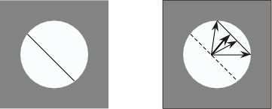
Aperture Problem
(a) (b)
(a) Line feature observed through a small aperture at time t.
(b) At time t+δt the feature has moved to a new position. It is not possible to determine exactly where each point has moved. From local image measurements only the flow component perpendicular to the line feature can be computed.
Normal flow: Component of flow perpendicular to line feature.

Slide 17
Brightness Constancy Equation
Let P be a moving point in 3D:
At time t, P has coords (X(t),Y(t),Z(t))
Let p=(x(t),y(t)) be the coords. of its image at time t.
Let E(x(t),y(t),t) be the brightness at p at time t.
Brightness Constancy Assumption:
As P moves over time, E(x(t),y(t),t) remains constant.

Slide 18
Brightness Constraint Equation
short:

Slide 19
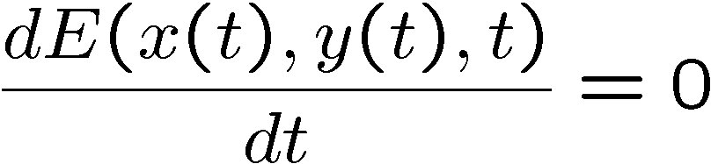
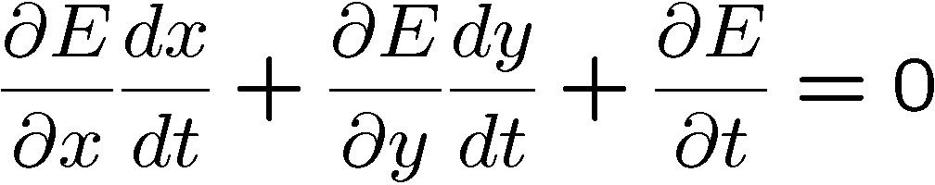
Brightness Constancy Equation
Taking derivative wrt time:

Slide 20
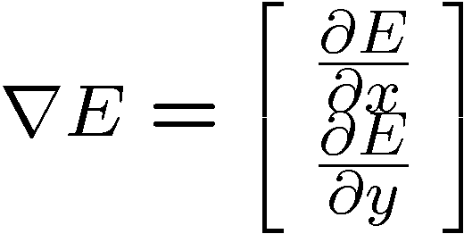
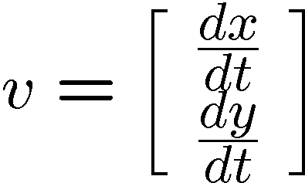
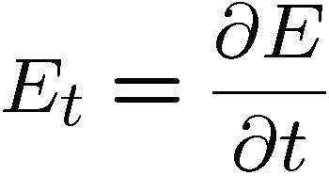
Brightness Constancy Equation
Let
(Frame spatial gradient)
(optical flow)
(derivative across frames)
and

Slide 21
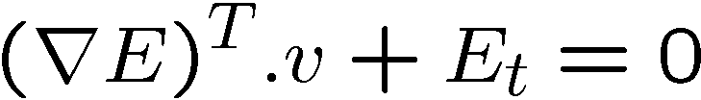
Brightness Constancy Equation
Becomes:
v_{y}
r E
-E_{t}/|r E|
v_{x}
The OF is CONSTRAINED to be on a line !

Slide 22
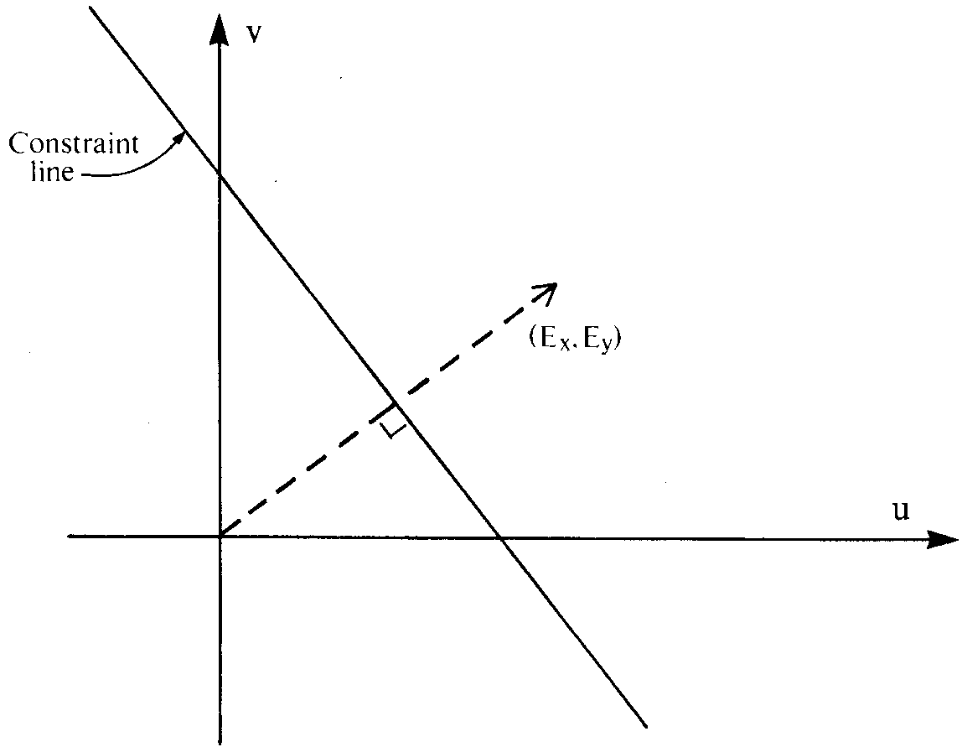
Interpretation
Values of (u, v) satisfying the constraint equation lie on a straight line in velocity space. A local measurement only provides this constraint line (aperture problem).

Slide 23
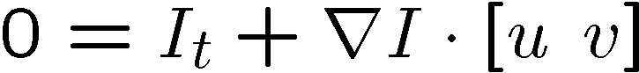
Optical flow equation
Barber Pole illusion
http://www.123opticalillusions.com/pages/barber_pole.php
Notes:
A: u and v are unknown, 1 equation

Slide 24
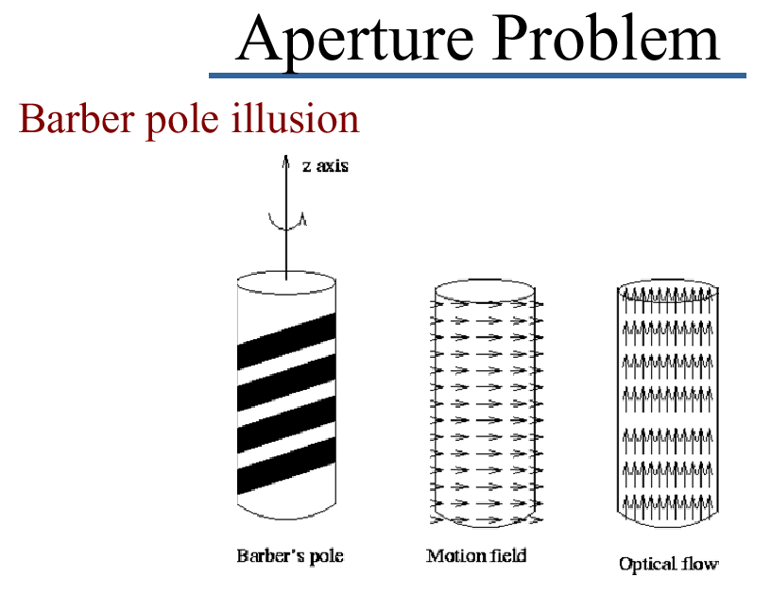
Aperture Problem in Real Life
actual motion perceived motion

Slide 25
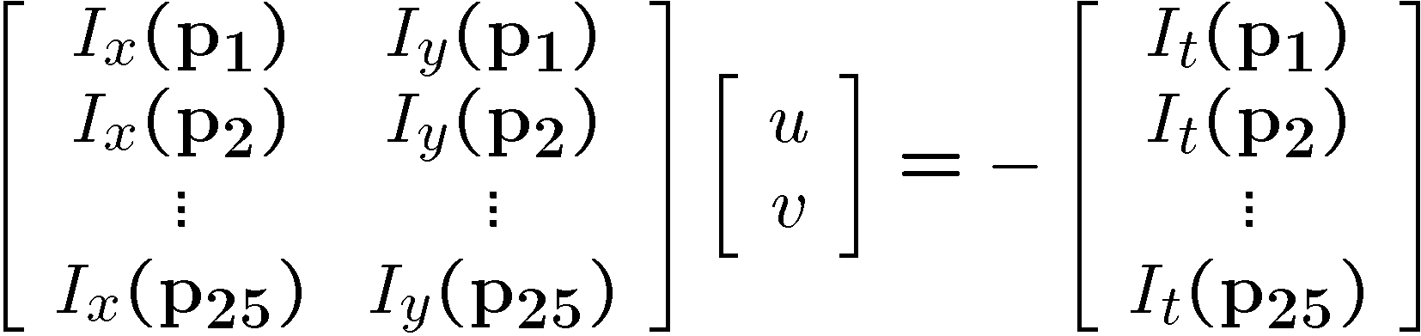

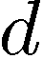
Solving the aperture problem
How to get more equations for a pixel?
Basic idea: impose additional constraints
most common is to assume that the flow field is smooth locally
one method: pretend the pixel’s neighbors have the same (u,v)
If we use a 5x5 window, that gives us 25 equations per pixel!

Slide 26
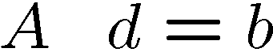
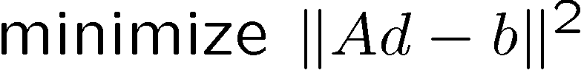
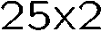
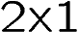
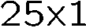
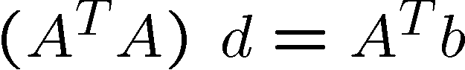

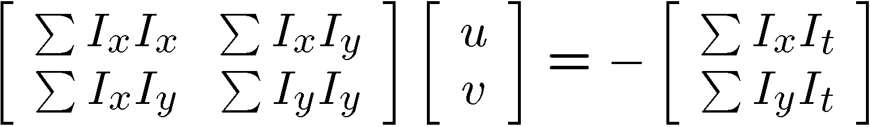
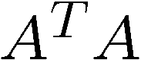
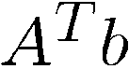
Constant flow
Prob: we have more equations than unknowns
Solution: solve least squares problem
minimum least squares solution given by solution (in d) of:
The summations are over all pixels in the K x K window
This technique was first proposed by Lukas & Kanade (1981)

Slide 27
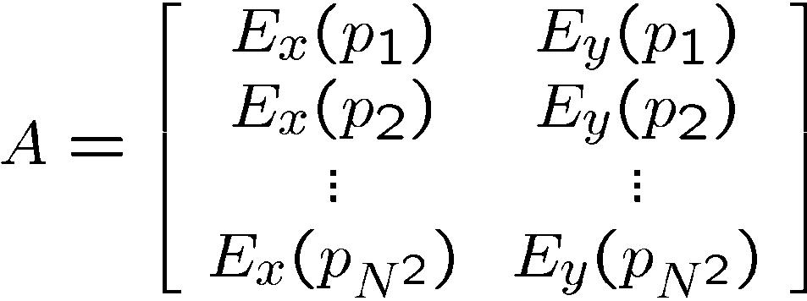
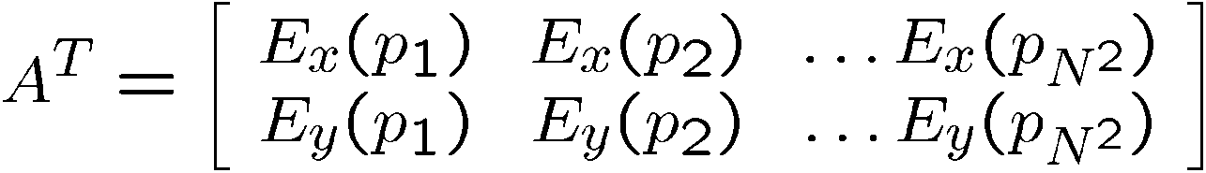
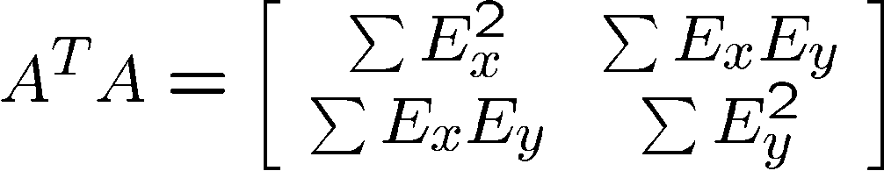
Taking a closer look at (A^{T}A)
This is the same matrix we used for corner detection!

Slide 28
Taking a closer look at (A^{T}A)
The matrix for corner detection:
is singular (not invertible) when det(A^{T}A) = 0
But det(A^{T}A) = ∏ λ_{i} = 0 -> one or both e.v. are 0
One e.v. = 0 -> no corner, just an edge
Two e.v. = 0 -> no corner, homogeneous region
Aperture Problem !

Slide 29
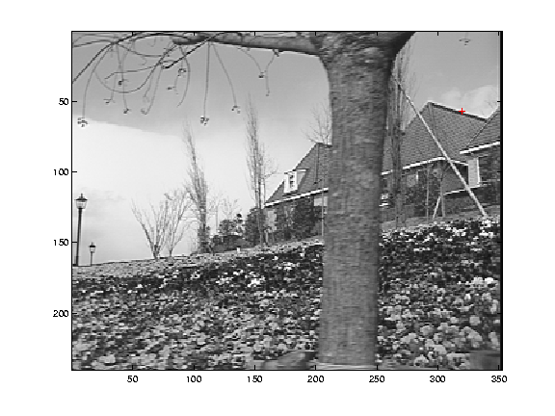
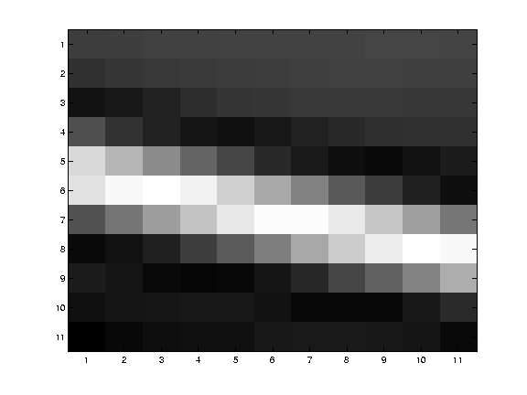
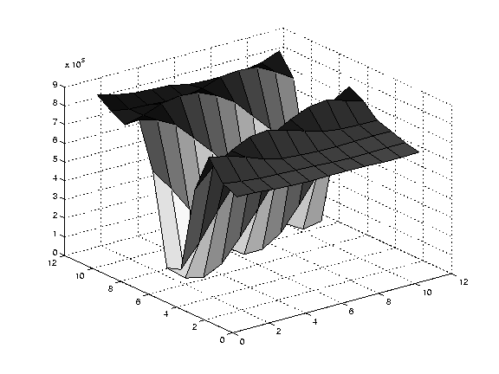
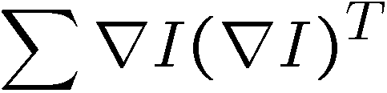
Edge
large gradients, all the same
large λ₁, small λ₂

Slide 30
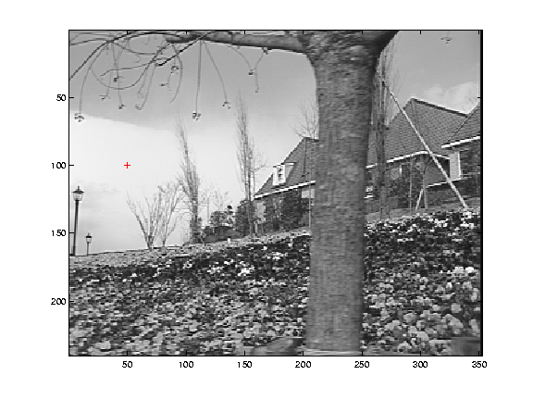
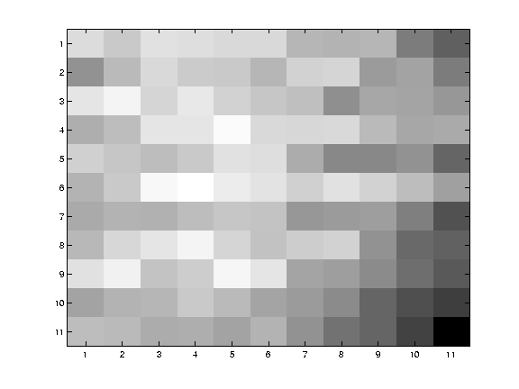
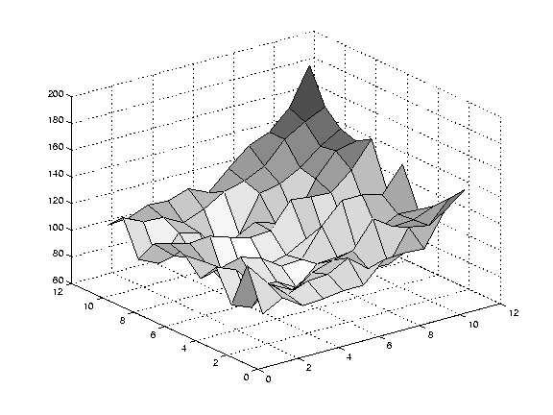
Low texture region
gradients have small magnitude
small λ₁, small λ₂

Slide 31
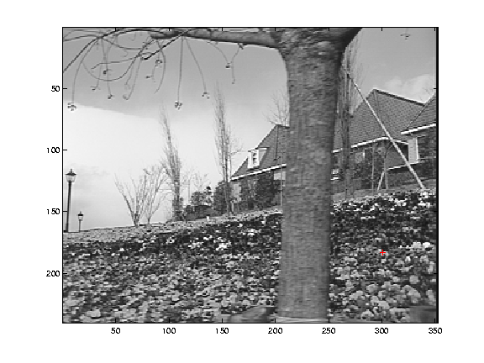
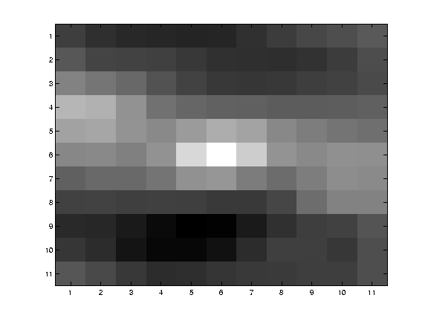
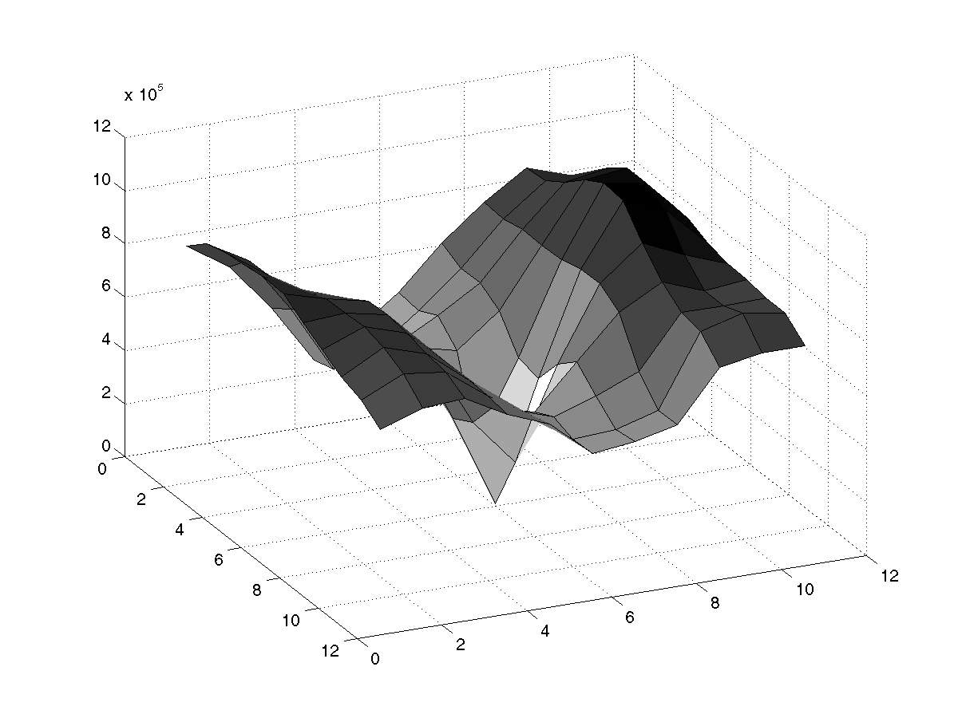
High textured region
gradients are different, large magnitudes
large λ₁, large λ₂

Slide 32
An improvement …
NOTE:
The assumption of constant OF is more likely to be wrong as we move away from the point of interest (the center point of Q)
Use weights to control the influence of the points: the farther from p, the less weight

Slide 33
Solving for v with weights:
Let W be a diagonal matrix with weights
Multiply both sides of Av = b by W:
W A v = W b
Multiply both sides of WAv = Wb by (WA)^{T}:
A^{T} WWA v = A^{T} WWb
A^{T} W²A is square (2x2):
(A^{T}W²A)⁻¹ exists if det(A^{T}W²A) ≠ 0
Assuming that (A^{T}W²A)⁻¹ does exists:
(A^{T} W²A)⁻¹ (A^{T} W²A) v = (A^{T} W²A)⁻¹ A^{T} W²b
v = (A^{T} W²A)⁻¹ A^{T} W²b

Slide 34
Observation
This is a problem involving two images BUT
Can measure sensitivity by just looking at one of the images!
This tells us which pixels are easy to track, which are hard
very useful later on when we do feature tracking...

Slide 35
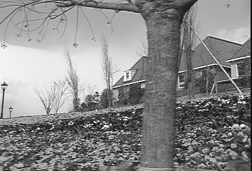
Revisiting the small motion assumption
Is this motion small enough?
Probably not—it’s much larger than one pixel (2nd order terms dominate)
How might we solve this problem?

Slide 36
Iterative Refinement
Iterative Lukas-Kanade Algorithm
Estimate velocity at each pixel by solving Lucas-Kanade equations
Warp I(t-1) towards I(t) using the estimated flow field
- use image warping techniques
Repeat until convergence

Slide 37
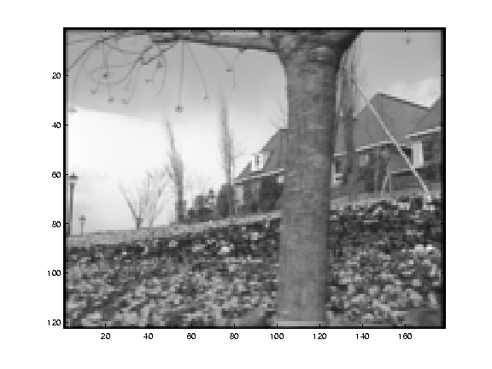
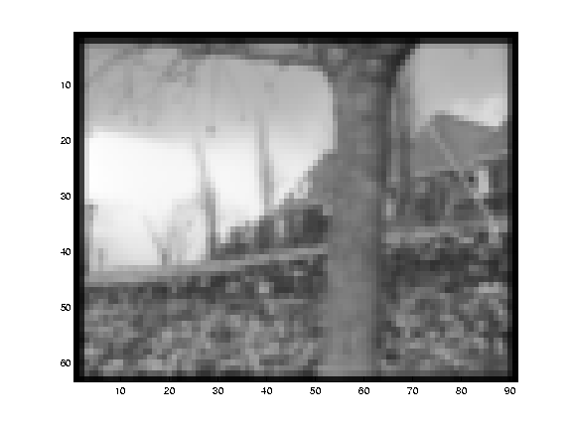
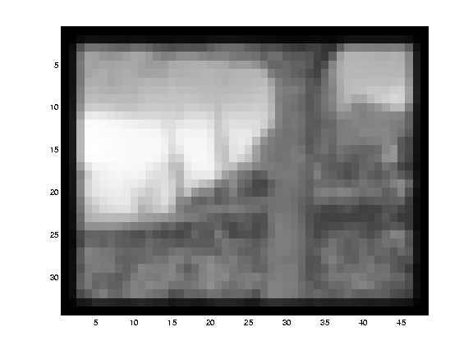
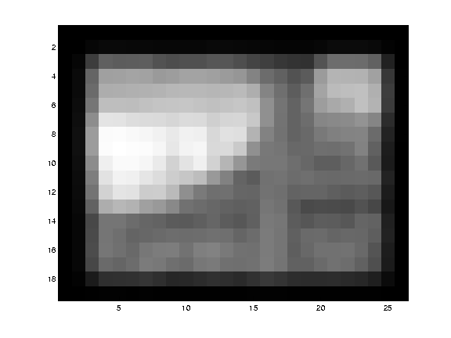
Reduce the resolution!

Slide 38
Coarse-to-fine optical flow estimation
u=1.25 pixels
u=2.5 pixels
u=5 pixels
image H
u=10 pixels
image H
image I
image I
Gaussian pyramid of image I_{t-1}
Gaussian pyramid of image I_{t}

Slide 39
Coarse-to-fine optical flow estimation
run iterative L-K
warp & upsample
run iterative L-K
.
.
.
image J
image H
image I
image I
Gaussian pyramid of image I_{t-1}
Gaussian pyramid of image I_{t}

Slide 40

Optical Flow Results
* From Khurram Hassan-Shafique CAP5415 Computer Vision 2003

Slide 41

Optical Flow Results
* From Khurram Hassan-Shafique CAP5415 Computer Vision 2003

Slide 42
Additional Constraints
Additional constraints are necessary to estimate optical flow, for example, constraints on size of derivatives, or parametric models of the velocity field.
Horn and Schunck (1981): global smoothness term
Minimize e_{c} + λ e_{s}
This approach is called regularization.
Solve by means of calculus of variation.

Slide 43


Discrete implementation leads to iterative equations
Geometric interpretation

Slide 44




Secrets of Optical Flow Estimation
What to mimimize:
quadratic penalty
Charbonnier penalty (related tL1, robust)
Lorentzian (related to paiwise MRF energy)
(D Sun, S. Roth and M. Black, CVPR 2010)

Slide 45
Preprocessing: filtering to reduce illumination changes is important, but does not have to be elaborate
Warping per pyramid level: 3 is sufficient
Interpolation method and computing derivatives: bicubic interpolation in warping and 5 point derivativeare good
Penalty function: Charbonier penalty best
(implemented with graduated non-convexity scheme)
Median filtering: on flow at each warping step

Slide 46
Conclusion
Classical (2 frame) optic flow methods have been pushed very far and are likely to improve incrementally
Big gains can only come from a processing of boundaries and surfaces over time

Slide 47
3 Computational Stages
1. Prefiltering or smoothing with low-pass/band-pass filters to enhance signal-to-noise ratio
2. Extraction of basic measurements (e.g., spatiotemporal derivatives, spatiotemporal frequencies, local correlation surfaces)
3. Integration of these measurements, to produce 2D image flow using smoothness assumptions

Slide 48
Energy-based Methods
Adelson Berger (1985), Watson Ahumada (1985), Heeger (1988): Fourier transform of a translating 2D pattern:
All the energy lies on a plane through the origin in frequency space
Local energy is extracted using velocity-tuned filters (for example, Gabor-energy filters)
Motion is found by fitting the best plane in frequency space
Fleet Jepson (1990): Phase-based Technique
Assumption that phase is preserved (as opposed to amplitude)
Velocity tuned band pass filters have complex-valued outputs

Slide 49
Correlation-based Methods
Anandan (1987), Singh (1990)
1. Find displacement (dx, dy) which maximizes cross correlation
or minimizes sum of squared differences (SSD)
2. Smooth the correlation outputs

Slide 50

A Pattern by Hajime Ouchi
Ouchi (1977)
Spillmann et. al (1993)
Fermüller, Pless, Aloimonos (2000)

Slide 51

Optic Flow Constraint Equation
Intensity is constant:
defines line in velocity space
Multiple measurements
or

Slide 52
Noise model
additive, identically, independently distributed, symmetric noise:

Slide 53


The idea
Solve a system A x = b
with noise : (A + δ_{A}) x = b + (δ_{b} )
Least Squares solution:
Bias
True value
Expected value:
Texture
The expected bias can be explained in terms of the eigenvalues of A’^{t}A.
Underestimation, more bias in direction of fewer measurements → direction towards majority of gradients in the patch

Slide 54



Why is this?
1D Example:
solution
A few examples
Because of the quadratic term
LS solution:

Slide 55


Slide 56

Estimated flow

Slide 57
Bias in Flow Estimation
Symmetric noise in spatial and temporal derivatives
Notation: δA=A-A', where A is the estimate, A' the actual value and δA the error
Underestimation in length
Bias in direction: more underestimation in direction of fewer measurements

Slide 58
Sources:
Horn (1986)
J. L. Barron, D. J. Fleet, S. S. Beauchemin (1994). Systems and Experiment. Performance of Optical Flow Techniques. IJCV 12(1):43–77. http://www.cs.toronto.edu/~fleet/research/Papers/ijcv-94.pdf (optical flow technique comparison)
http://cs.brown.edu/~dqsun/research/software.html (Matlab optic flow code)
http://vision.middlebury.edu/flow/ (Middlebury optic flow evaluation)
http://www.cfar.umd.edu/~fer/postscript/ouchi-main.pdf (paper on Ouchi illusion)

